Slide 1
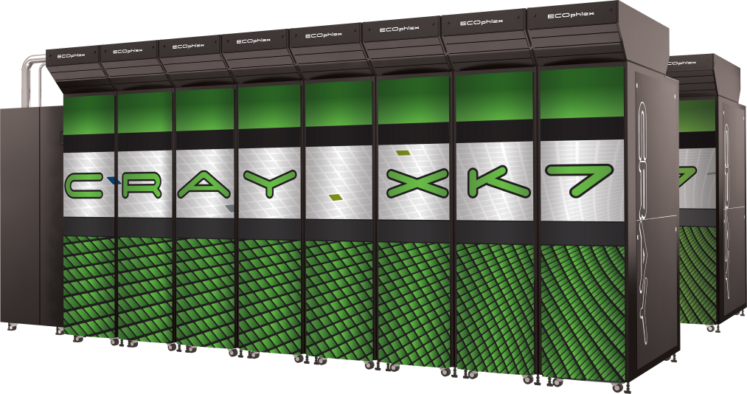
An Introduction to OpenACC
Alistair Hart
Cray Exascale Research Initiative Europe

Slide 2
Timetable
Monday 18th February 2013
10:10 Lecture 1: Introduction to the Cray XK7
10:30 Lecture 2: Using the Cray XK7 Programming Env.
10:50 Practical 0: Logging on, running a very simple job
11:00 break
11:30 Lecture 3: Basic OpenACC
12:15 Practical 1: A first OpenACC code
12:40 Lecture 4: Porting a simple example to OpenACC
13:10 lunch
14:10 Lecture 5: OpenACC debugging (CSCS)
14:30 Practical 2: Porting the simple example yourself
15:00 Lecture 6: Advanced OpenACC
15:40 Lecture 7: Using Cray PE tools to port a code
16:10 Practical 3: Using the tools to port a larger code
16:30 break
16:50 Lecture 8: Porting a parallel code to OpenACC
17:20 Lecture 9: OpenACC interoperability and roadmap
17:40 Practical 3 (continued) and discussions
18:00 close

Slide 3
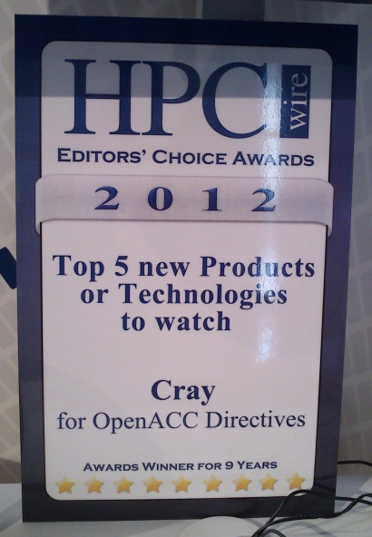
A year is a long time...
I came to CSCS this time last year to speak about OpenACC
Since then:
CSCS has a beautiful new building
fewer donkeys outside, but much more elegant
Tödi moved but also grew and upgraded from Cray XK6 to XK7
the first accepted Cray XK7 system (I think)
OpenACC issued a technical report outlining what's coming in v2.0
Cray, PGI and CAPS released compilers supporting all of OpenACC v1.0
Cray and PGI had OpenACC tutorials at SC12
OpenACC got an HPCwire Editors' Choice award
Cray installed two enormous Cray XK7 systems
ORNL Titan (200 cabinets, each with 96 GPUs)
NCSA Blue Waters (30 cabinets, plus 200+ Cray XE6)
plus a lot of smaller (but no less important) ones

Slide 4
Contents
The aims of this course:
To motivate why directive-based programming of GPUs is useful
To introduce you to the OpenACC programming model
To give you some experience in using OpenACC directives
with some hints and tips along the way
To introduce you to profiling tools
to understand and tune OpenACC performance
to help you understand a real application to start OpenACC-ing...
The idea is to equip you with the knowledge to develop applications that run efficiently on parallel hybrid supercomputers
not just on single GPUs

Slide 5
Inside the Cray XK7 and the Nvidia Kepler K20X GPU
Alistair Hart
Cray Exascale Research Initiative Europe

Slide 6
Contents of this talk
An overview of the Cray XK7
The hardware
Why GPUs are interesting for Exascale research
Programming models for GPUs
A quick GPU refresher
the hardware
how codes execute on the hardware
what this means for the programmer
Things to consider before starting an OpenACC port

Slide 7
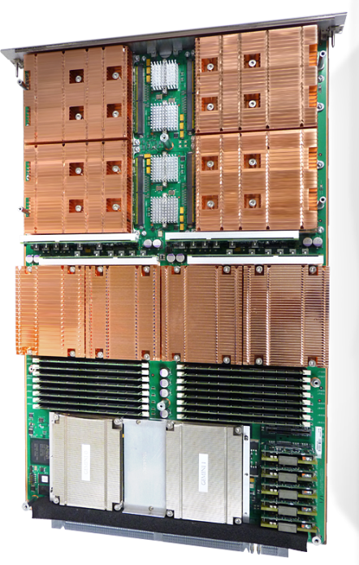
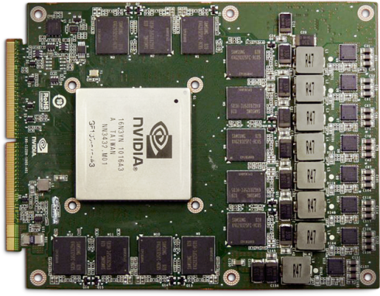
"Accelerating the Way to Better Science"
Cray XK6 supercomputer
Node architecture:
One AMD Series 6200 Interlagos CPU (16 cores)
Cray XE6 (e.g. HECToR) has two of these per node
One Nvidia GPU
Currently Fermi+
512 cores, 665 GFlop/s DP, 6GB memory
Upgradable to Kepler
1536 cores
Cray Gemini interconnect
shared between two nodes
high bandwidth/low latency scalability
Fully integrated/optimised/supported
Tight integration of GPU and NIC drivers
Notes:
Single cabinet XK6 96 nodes (some service). Cheaper than you think: within the budget of a typical single-institution HPC grant from EPSRC or STFC, for instance.

Slide 8
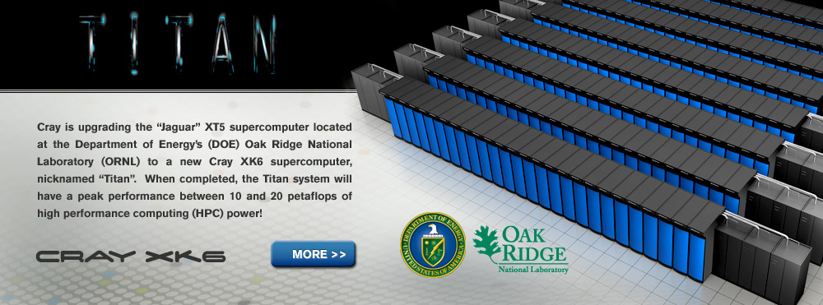
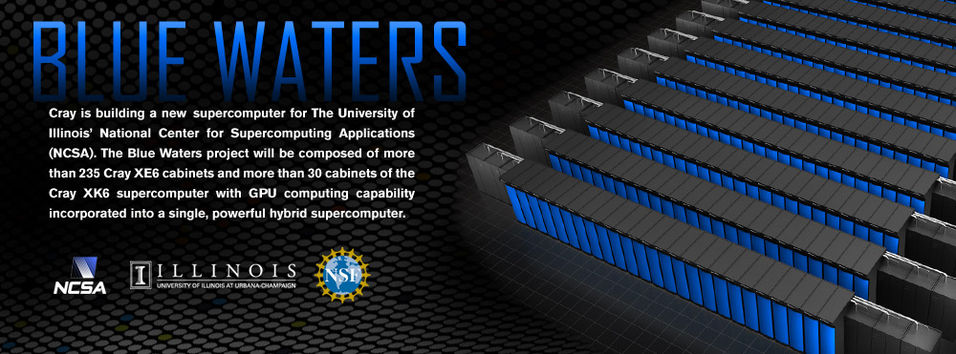
Cray hybrids in future Top500
ORNL Titan: 200 cabinets of Cray XK6 (19k nodes, all with Kepler GPUs)
NCSA Blue Waters: 235 cabinets of Cray XE6 + 30 cabinets of Cray XK6

Slide 9
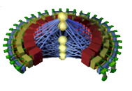
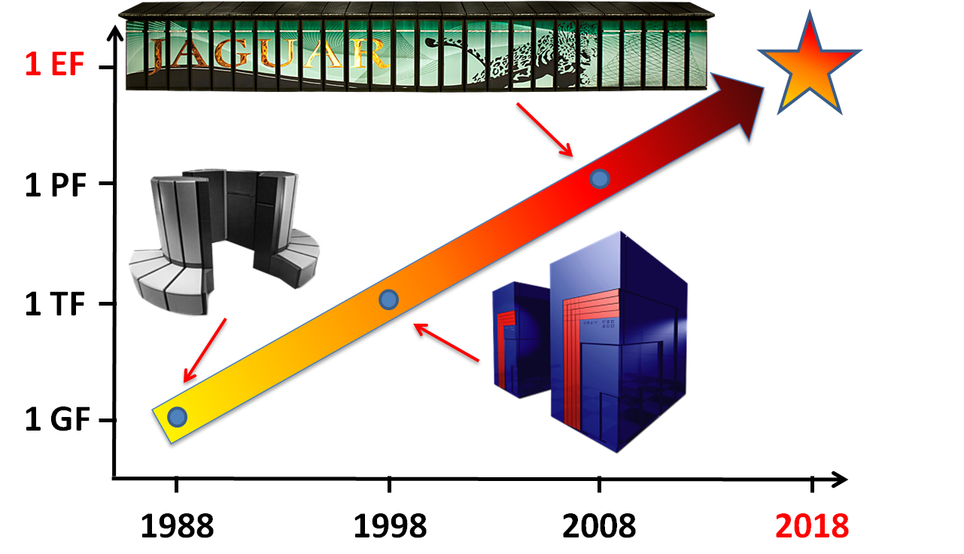
The Exascale is coming...
Sustained performance milestones every 10 years...
1000x the performance with 100x the PEs
(and they're all Crays)

Slide 10
Exascale, but not exawatts
Power is a big consideration in an exascale architecture
Jaguar XT (ORNL) draws 6MW to deliver 1PF
The US DoE wants 1EF, but using only 20MW...
A hybrid system is one way to reach this, e.g.
10⁵ nodes (up from 10⁴ for Jaguar)
10⁴ FPUs/node (up from 10 for Jaguar)
some full-featured cores for serial work
a lot more cutdown cores for parallel work
Instruction level parallelism will be needed
continues the SIMD trend SSE → AVX → ...
This looks a lot like the current GPU accelerator model
manycore architecture, split into SIMT threadblocks
Complicated memory space/hierarchy (internal and PCIe)
And this looks a lot like the old days
welcome back to vectorisation, we kept the compiler ready for you

Slide 11

The Exascale furrow is a hard one to plough...
Seymour Cray, the pioneer of supercomputing, famously once asked if you would rather plough a field with two strong oxen or five-hundred-and-twelve chickens.
Since then, the question has answered itself: power restrictions have driven CPU manufacturers away from “oxen” (powerful single-core devices) towards multi- and many-core “chickens”.
An exascale supercomputer will take this a step further, connecting tens of thousands of many-core nodes.
Application programmers face the challenge of harnessing the power of tens of millions of threads.
EPCC News, issue 70 (Autumn 2011)

Slide 12

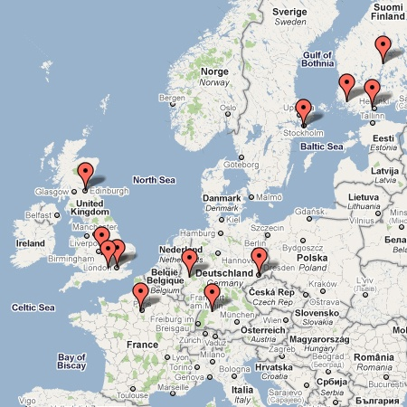
EU FP7 Network: Collaborative Research into Exascale Software Tools and Applications
Consortium has
Leading European HPC centres
EPCC, HLRS, CSC, PDC
Hardware partner
Cray
Tools providers
TUD (Vampir), Allinea (DDT)
Codesign application owners, specialists
ABO, JYU, UCL, ECMWF, ECP, DLR
Codesign approach
Focus on real problems in real applications
6 apps: GROMACS, OpenFOAM, IFS,
Elmfire, Nek5000, HemeLB
CRESTA and its two partner projects are the first Exascale development projects funded by Europe
Runs from Oct. 2011-Sept. 2014
CRESTA workshop on Exascale codesign at SC12 now recruiting speakers

Slide 13
Accelerator programming
Why do we need a new GPU programming model?
Aren’t there enough ways already?
CUDA (incl. NVIDIA CUDA-C & PGI CUDA-Fortran)
OpenCL
Stream
hiCUDA ...
All are quite low-level and closely coupled to the GPU
User needs to rewrite kernels in specialist language:
Hard to write and debug
Hard to optimise for specific GPU
Hard to port to new accelerator
Multiple versions of kernels in codebase
Hard to add new functionality

Slide 14

CUDA for experts
If you work hard, you can get good parallel performance
Ludwig Lattice Boltzmann code rewritten in CUDA
Reordered all the data structures (structs of arrays)
Pack halos on the GPU
Streams to overlap compute,
PCIe comms, MPI halo swaps
10 cabinets of Cray XK6
936 GPUs (nodes)
Only 4% deviation from
perfect weak scaling between
8 and 936 GPUs.
But...
Most applications don't have this level
of expert developer support

Slide 15
Directive-based programming
Directives provide a high-level alternative
Based on original source code (e.g. Fortran, C, C++)
Easier to maintain/port/extend code
Users with (for instance) OpenMP experience find it a familiar programming model
Compiler handles repetitive boilerplate code (cudaMalloc, cudaMemcpy...)
Compiler handles default scheduling; user can step in with clauses where needed
Possible performance sacrifice
Important to quantify this
Can then tune the compiler
Small performance sacrifice is an acceptable trade-off for portability and productivity
After all, who handcodes in assembler for CPUs these days?

Slide 16
Performance compared to CUDA
Is there a performance gap relative to explicit low-level programming model? Typically 10-15%, sometimes none.
Is the performance gap acceptable? Yes.
e.g. S3D comp_heat kernel (ORNL application readiness):

Slide 17
Node-for-node performance comparison
Does accelerated parallel application performance justify buying a GPU on the node (e.g. Cray XK6)
rather than another CPU (cf. Cray XE6)?
For many codes, yes.

Slide 18
Structure of this course
Aims to lead you through the entire development process
What is OpenACC?
How do I use it in a simple code?
How do I port a real-sized application?
Performance tuning and advanced topics
It will assume you know
A little bit about GPU architecture and programming
SMs, threadblocks, warps, coalescing
a quick refresher follows
It will help if you know
The basic idea behind OpenMP programming
but this is not essential

Slide 19
A quick GPU refresher

Slide 20
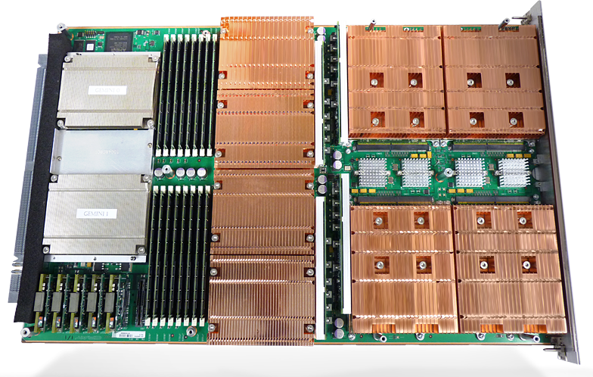
How fast are current GPUs?
Beware the hype: "I got 1000x speed-up on a GPU"
What should you expect?
Cray XK7:
Flop/s: GPU ~9x faster than single, whole CPU (16 cores)
Memory bandwidth: GPU ~6x faster than CPU
These ratios are going to be similar in other systems
Plus, it is harder to reach peak performance on a GPU
Your code needs to fit the architecture
You also need to factor in data transfers between CPU and GPU
32GB
SDRAM
6 GB
GDDR
~42 GB/s
~250 GB/s
CPU
~150 GF
GPU
~1.3 TF
PCIe-2
8 GB/s
Notes:
Fermi X2090 Kepler K20x Kepler K20
memory 6 GB 6 GB 5 GB
mem b/w: 177 GB/s 250 GB/s 208 GB/s
Flop/s, DP: 665 GF 1.31 TF 1.17 TF
Flop/s, SP: 1.31 TF 3.95 TF 3.52 TF

Slide 21
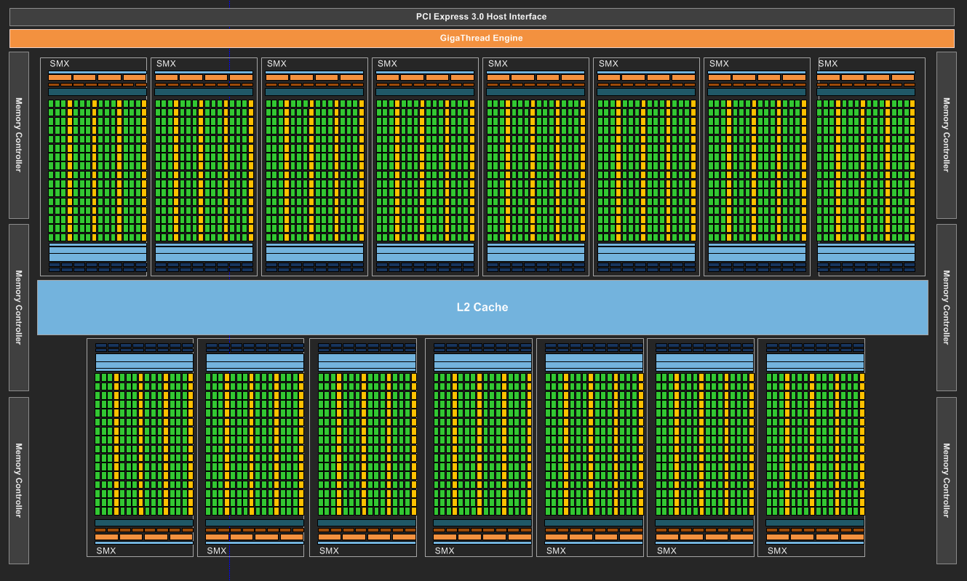
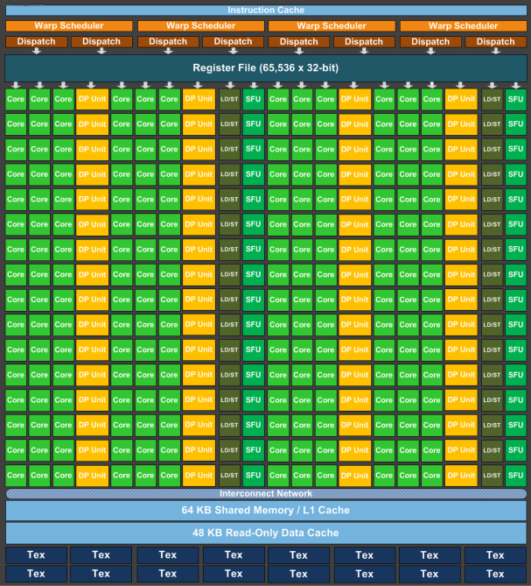
Nvidia K20X Kepler architecture
Global architecture
a lot of compute cores
2688 SP plus 896 DP; ratio 3:1
divided into 14 Streaming Multiprocessors
these operate independently
SMX architecture
many cores
192 SP
64 DP
shared instruction stream; same ops
lockstep, SIMT execution of same ops
SMX acts like vector processor
Memory hierarchy
each core has private registers
fixed register file size
cores in an SM share a fast memory
64KB, split between:
L1 cache and user-managed
all cores share large global memory
6GB; also some specialist memory

Slide 22
Program execution on a GPU
Kernels are launched by CPU to execute on GPU
CUDA programming model:
parallel work divided between large number of lightweight threads
threads are divided into logical sets (known as threadblocks)
The GPU runtime schedules these on the GPU hardware
each threadblock executes on an SM
threads in threadblock have some shared memory
you can synchronise the threads in a threadblock
different threadblocks execute on different SMs
runtime dynamically swaps threadblocks in and out of execution
to hide memory latency
there is no mechanism for synchronising between threadblocks within kernel
The kernels launch asynchronously
global synchronisation is handled by the host at the end of the kernel
host also handles and synchronises memory copies between CPU and GPU
Notes:
Not mentioned: concept of stream of operations
Not mentioned: occupancy

Slide 23
What CUDA doesn't tell you (upfront)
Threads are not created equal
The SM is really a vector processor of width 32
groups of 32 cores act in lockstep, rather than independently
shares a single instruction stream with single program counter
Threads within a threadblock are divided into sets of 32 (warps)
each warp executes in SIMT fashion using 32 cores of SM
if a threadblock contains multiple warps, these are executed in turn
i.e. if there are more than 32 threads in the threadblock
Memory loads/stores are also done on a per-warp basis
Loading/storing 32 consecutive memory addresses at once
So really, the compiler is implementing your code using vector instructions
This is not explicit in the CUDA programming model, but is crucial to gaining good performance from a GPU
whichever programming model you are using (it's a hardware thing)
Notes:
Loads and stores are done using half warps rather than warps, but the distinction is not important.

Slide 24
What does this mean for the programmer?
You need a lot of parallel tasks (i.e. loop iterations) to keep GPU busy
Not just 2688, but 10⁴ to 10⁶ to allow runtime to hide memory latency
Your loop(s) must vectorise (at least with vector length of 32)
So we can use all 32 threads in a warp with shared instruction stream
Branches in loopnests are allowed, but too many will be an issue
Global memory access is done with (sequential) vector loads
For good performance, want as few of these as possible
so all the threads in warp collectively load a contiguous block of memory at the same point in the instruction stream
This is known as "coalesced memory access"
So threads should access fastest-moving index of each array
No internal mechanism for synchronising between threadblocks
So reduction operations are more complicated, for instance, even though all threadblocks share same global memory
Data transfers between CPU and GPU are very expensive
You need to concentrate on "data locality" and avoid "data sloshing"
Keeping data in the right place for as long as it is needed is crucial
This probably means porting more of the application than you expected
Notes:
2688 is the number of physical (SP) cores for the K20X.
Kepler dynamic parallelism does offer a partial method for synchronisation; a kernel launched from a kernel. The second level kernel will globally complete before control is returned to the original kernel. But this is quite advanced.
Improved atomic operations in Kepler amy also simplify reductions; atomic operations are perhaps fast enough to do reductions directly in global memory, rather than using a more complicated process (e.g. two separate kernels).

Slide 25
So...
GPUs are like race-horses
can give very good performance
but it needs to be carefully coaxed from them
porting a real application to GPU(s) requires some hard work
Amdahl says you need to port a lot of the profile to see a speed-up
bad news: to see 10x speedup, need to port at least 90% of the application profile
good news: if profile very peaked, 90% of time may be spent in, say, 40% of code
even before you worry about data transfers
A good programming model and environment
bridges the gap between peak performance and achievable performance
Directive-based programming can help a lot
there is still much work to do, but you can spend more time thinking and less time on the donkey work
The good news:
A lot of the work done in an OpenACC port increases performance on the CPU as well

Slide 26
Strategic risk factors
Will there be machines to run my OpenACC code on?
Now? Lots of Nvidia GPU accelerated systems
Cray XK7s: CSCS tödi, HLRS hermit, ORNL titan...
Lots of other GPU machines in Top100 (OpenACC is multi-vendor)
Future? OpenACC can be targetted at other accelerators
PGI and CAPS already target Intel Xeon Phi, AMD GPUs
Plus you can always run on CPUs using same codebase
Will OpenACC continue?
Support? Cray and PGI (at least) are committed to support OpenACC
Lots of big customer pressure to continue to run OpenACC
Develop? OpenACC committee now finalising v2.0 of standard
Lots of new partners joined committee at end of last year
Will OpenACC be superseded by something else?
Auto-accelerating compilers? If only!
Never really managed it for threading real HPC applications on the CPU
Data locality adds to the challenge
OpenMP accelerator directives? OpenACC work not wasted
Very similar programming model; can transition when these release if wish
Cray (co-chair), PGI very active in OpenMP accelerator subcommittee
Notes:
This slide aims to answer some questions that have been raised that question whether OpenACC has permanance.

